Slide 1
Employee Demographics: FritoLay
Joel Laskow

Slide 2
Statement of Purpose
The purpose of this presentation is to outline the results of our analysis of employee demographic information provided by FritoLay.

Slide 3
Statement of Purpose
The purpose of this presentation is to outline the results of our analysis of employee demographic information provided by FritoLay.
Sections:

Slide 4
Statement of Purpose
The purpose of this presentation is to outline the results of our analysis of employee demographic information provided by FritoLay.
Sections:
Part 1: Attrition Prediction

Slide 5
Statement of Purpose
The purpose of this presentation is to outline the results of our analysis of employee demographic information provided by FritoLay.
Sections:
Part 1: Attrition Prediction
Part 2: MonthlyIncome (Salary) Prediction

Slide 6
Statement of Purpose
The purpose of this presentation is to outline the results of our analysis of employee demographic information provided by FritoLay.
Sections:
Part 1: Attrition Prediction
Part 2: MonthlyIncome (Salary) Prediction
Part 3: Future Projects and Conclusions

Slide 7
Data Used

Slide 8
Data Used
Reference Dataset
870 Employees

Slide 9
Data Used
Reference Dataset
870 Employees
300 Employees
Attrition Unknown Dataset

Slide 10
Data Used
Reference Dataset
870 Employees
300 Employees
300 Employees
Attrition Unknown Dataset
Monthly Income Unknown Dataset

Slide 11
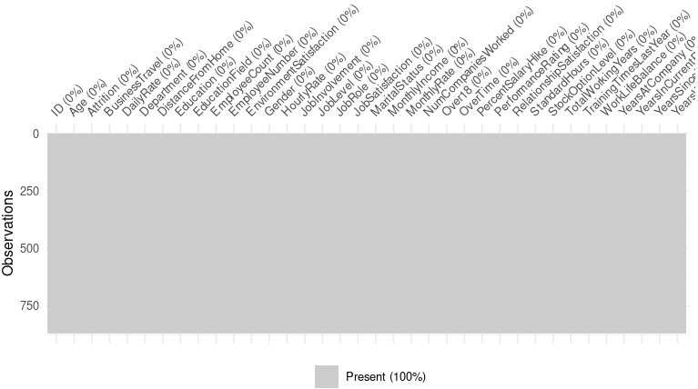
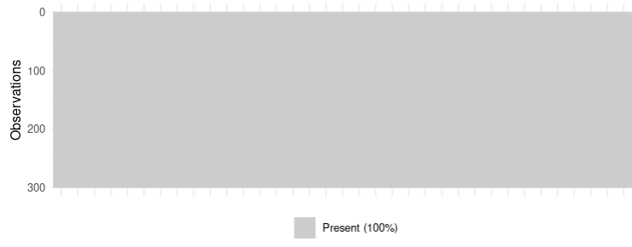
Reference Dataset
Attrition Unknown Dataset
Monthly Income Unknown Dataset

Slide 12
Part 1: Predicting Attrition
Key Task: Predict which employees are likely to quit and which are not.

Slide 13
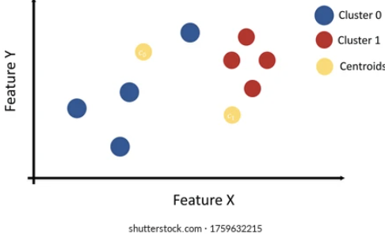
Part 1: Predicting Attrition
Key Task: Predict which employees are likely to quit and which are not.
Method 1:
KNN Clustering

Slide 14
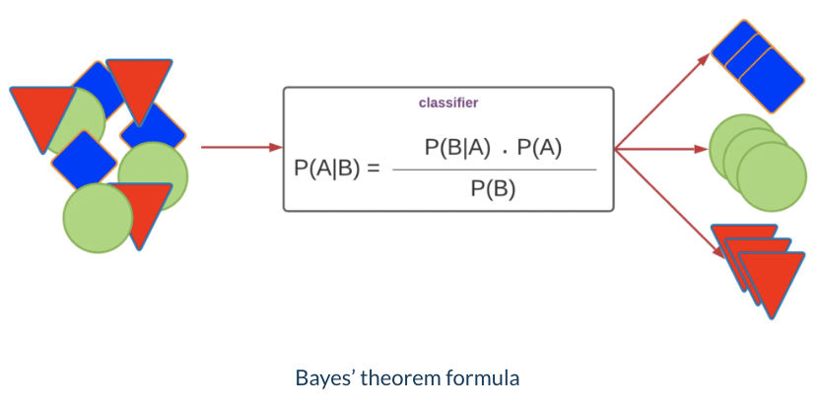
Part 1: Predicting Attrition
Key Task: Predict which employees are likely to quit and which are not.
Method 2:
Naive Bayes Prediction
Notes:
Image source:
https://mlarchive.com/machine-learning/the-ultimate-guide-to-naive-bayes/

Slide 15
Part 1: Predicting Attrition
Analysis Pipeline
Variable Selection
2) Train Naive Bayes and KNN Models
3) Model Selection
4) Predictions
Notes:
Image source:
https://mlarchive.com/machine-learning/the-ultimate-guide-to-naive-bayes/

Slide 16
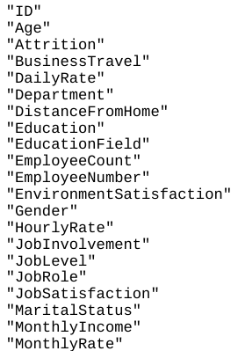
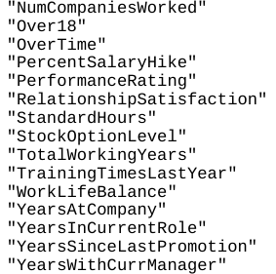
Variable Selection
36 Variables Total!
So which variables are the best to use?
4 Models Tested: Full-model KNN, Reduced-Model KNN, Full-Model NaiveBayes, Reduced-Model Naive Bayes

Slide 17
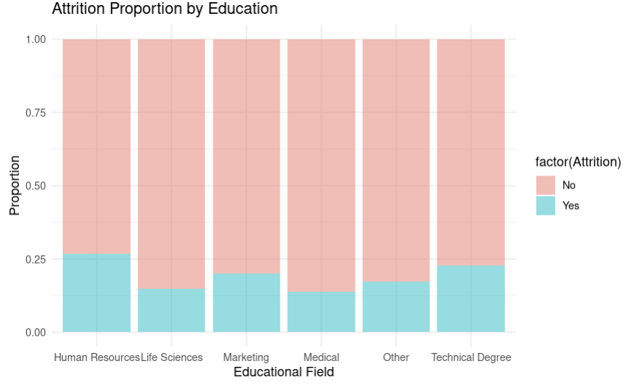
Educational Field
Attrition seems to vary with educational field

Slide 18
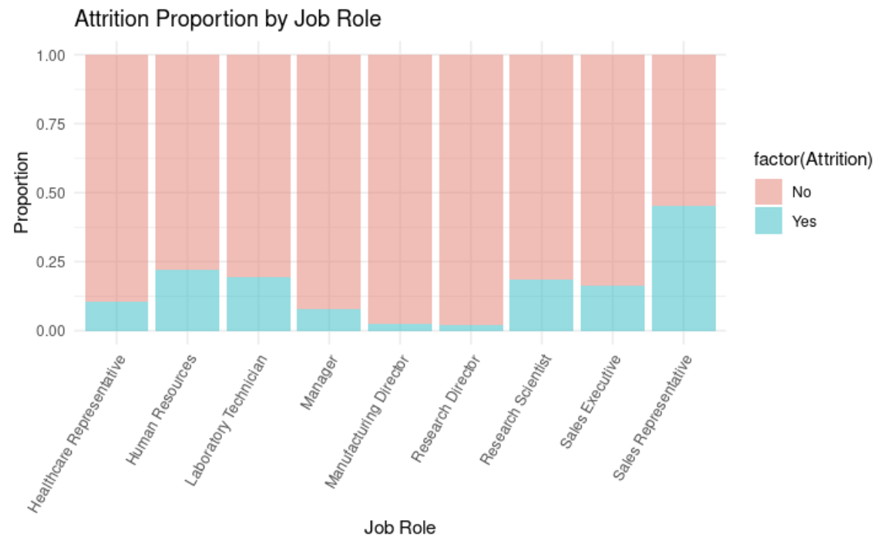
Job Role
Attrition proportions fluctuate with Job Role

Slide 19
Job Role
Sales Reps have a near 50:50 chance of quitting!
Attrition proportions fluctuate with Job Role

Slide 20
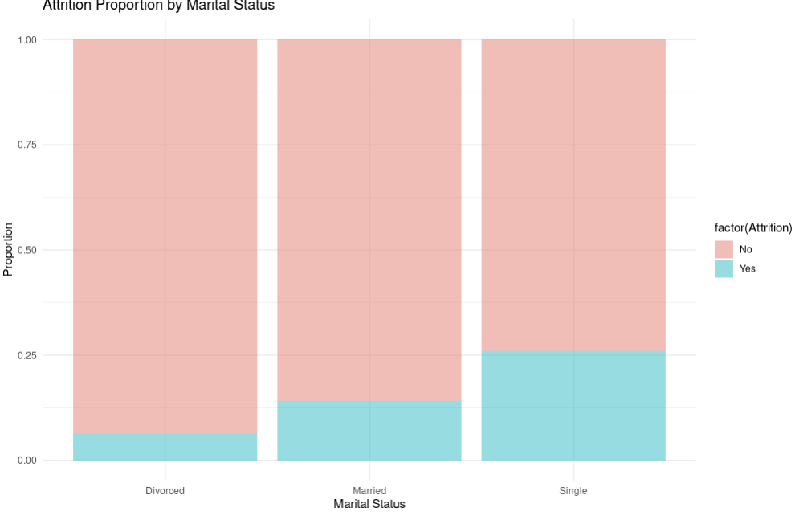
Marital Status
Single employees display higher proportion of attrition. Divorced employees display lowest proportion
Notes:
Future studies might explore this more. Are single employees more inclined to quit, or are other factors at play here?
Divorced: ~6% Quit
Single: 26% Quit

Slide 21
Marital Status
~26% of Singles Quit
Single employees display higher proportion of attrition. Divorced employees display lowest proportion
Notes:
Future studies might explore this more. Are single employees more inclined to quit, or are other factors at play here?
Divorced: ~6% Quit
Single: 26% Quit

Slide 22
Marital Status
~14% of Married Quit
Single employees display higher proportion of attrition. Divorced employees display lowest proportion
Notes:
Future studies might explore this more. Are single employees more inclined to quit, or are other factors at play here?
Divorced: ~6% Quit
Single: 26% Quit

Slide 23
Marital Status
~6% of Divorced Quit
Single employees display higher proportion of attrition. Divorced employees display lowest proportion
Notes:
Future studies might explore this more. Are single employees more inclined to quit, or are other factors at play here?
Divorced: ~6% Quit
Single: 26% Quit

Slide 24
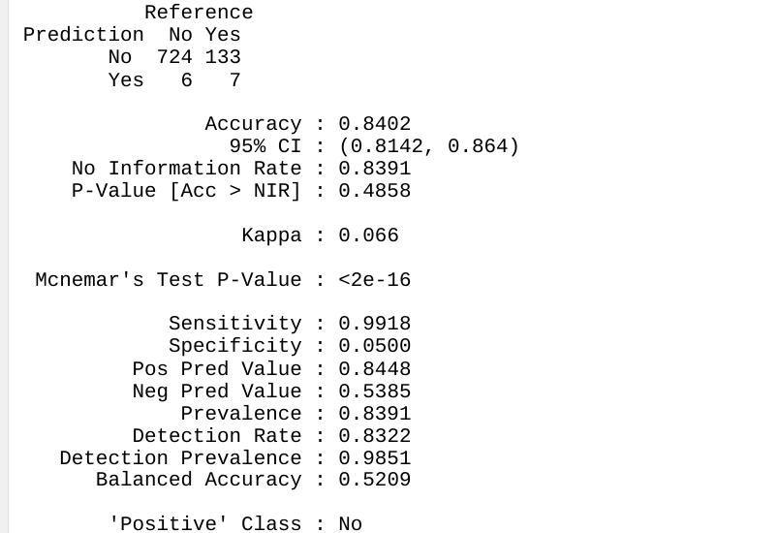
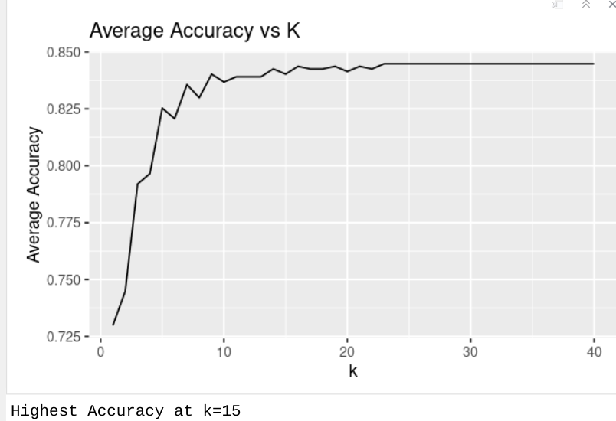
Full Model KNN
Avg Acc | 0.8391
Avg Spec | 0.3571
Avg Sens | 0.99315
Notes:
Future studies might explore this more. Are single employees more inclined to quit, or are other factors at play here?
Divorced: ~6% Quit
Single: 26% Quit

Slide 25
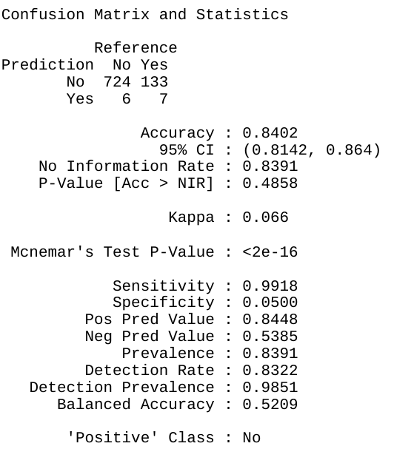
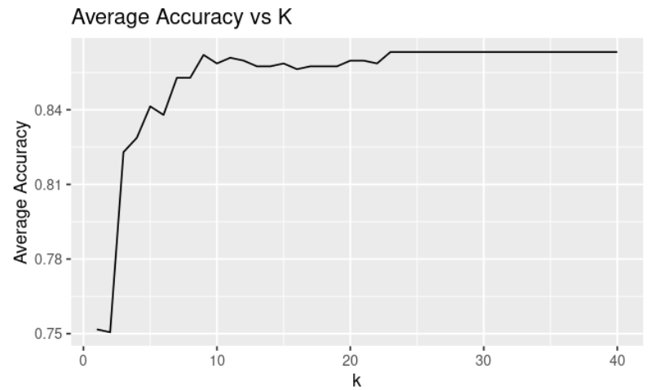
Reduced Model KNN
Attrition ~ EducationField + Department + Gender + JobRole
Avg Acc | 0.8402
Avg Spec | 0.0500
Avg Sens | 0.9918
Notes:
Future studies might explore this more. Are single employees more inclined to quit, or are other factors at play here?
Divorced: ~6% Quit
Single: 26% Quit

Slide 26
Naive Bayes Models
 | Full Model | Reduced Model
Average Accuracy | 0.8391379 | 0.8254598
Average Specificity | 0.5515502 | 0.120365
Average Sensitivity | 0.8958887 | 0.9643062
Notes:
Future studies might explore this more. Are single employees more inclined to quit, or are other factors at play here?
Divorced: ~6% Quit
Single: 26% Quit

Slide 27
Naive Bayes Models
 | Full Model | Reduced Model
Average Accuracy | 0.8391379 | 0.8254598
Average Specificity | 0.5515502 | 0.120365
Average Sensitivity | 0.8958887 | 0.9643062
Notes:
Future studies might explore this more. Are single employees more inclined to quit, or are other factors at play here?
Divorced: ~6% Quit
Single: 26% Quit

Slide 28
Full Model Naive Bayes Predictions
Likely to Quit | Not Likely to Quit
47 | 253
Notes:
Future studies might explore this more. Are single employees more inclined to quit, or are other factors at play here?
Divorced: ~6% Quit
Single: 26% Quit

Slide 29
Full Model Naive Bayes Predictions
Likely to Quit | Not Likely to Quit
47 | 253
~ 16% Attrition Predicted
Full document on Github
Notes:
Future studies might explore this more. Are single employees more inclined to quit, or are other factors at play here?
Divorced: ~6% Quit
Single: 26% Quit

Slide 30
Part 2: Predicting Monthly Income
Key Task: Predict the monthly income of employees in our No_Salary dataset
Method:
Regression

Slide 31
Part 2: Predicting Monthly Income
Analysis Pipeline
Variable Selection
2) Model Construction
3) Model Evaluation
4) Predictions

Slide 32
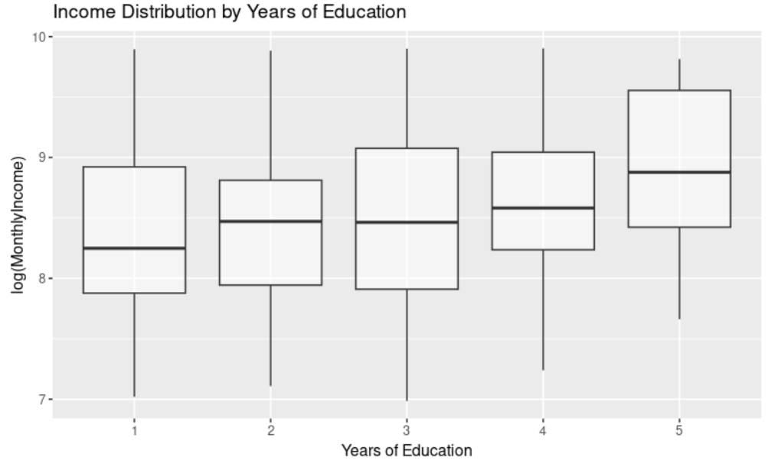
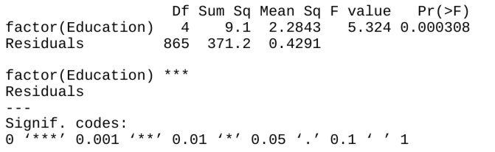
Variable 1:
Years of Education
Sufficient evidence to suggest median income is NOT equivalent for each education group

Slide 33
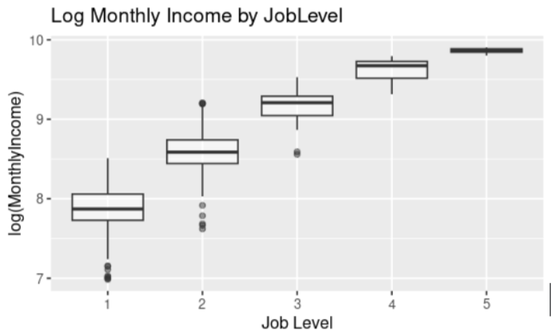
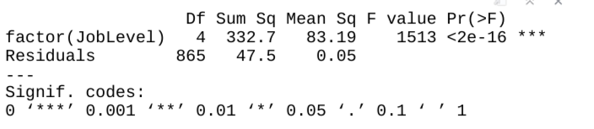
Variable 2:
Job Level
Considerable evidence suggesting monthly income changes with job level

Slide 34
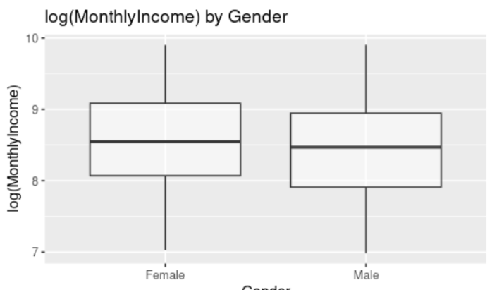
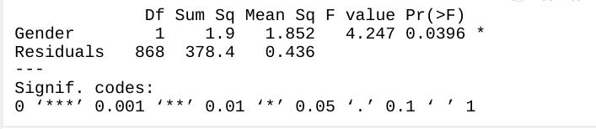
Variable 3:
Gender
Some evidence suggesting median monthly income is not equal across Gender

Slide 35
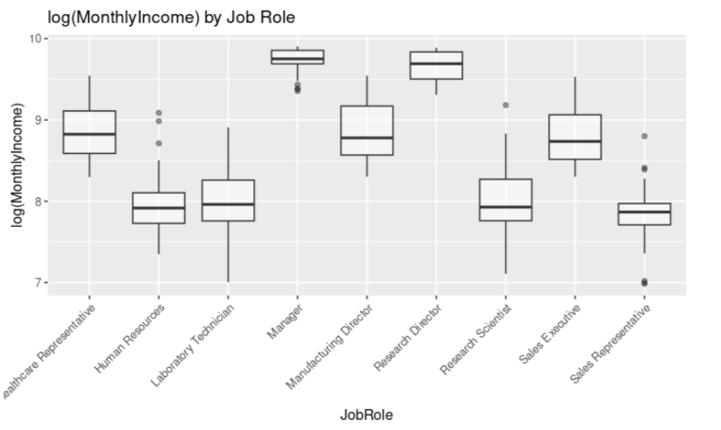
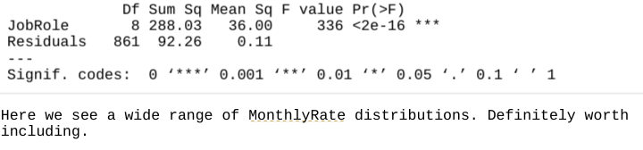
Variable 4:
Job Role
Considerable evidence income changes with Job Role

Slide 36
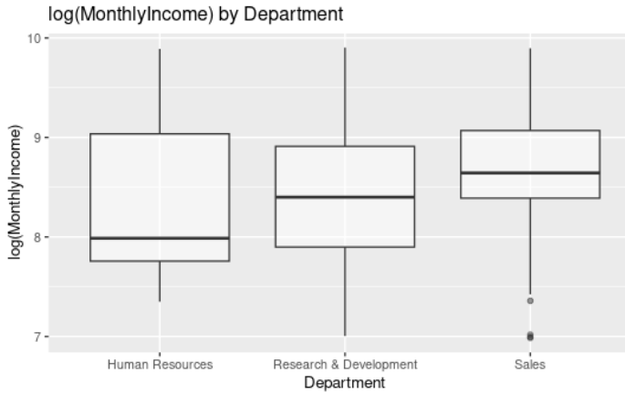
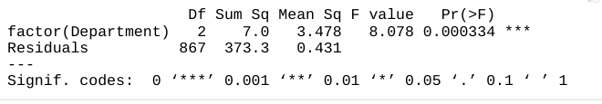
Variable 5:
Department
Strong evidence that income changes with Department

Slide 37
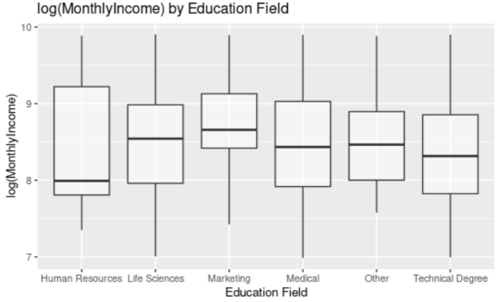
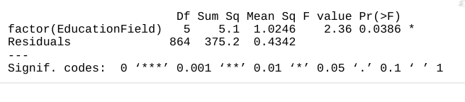
Variable 6:
Education Field
Strong evidence income changes with Education Field

Slide 38
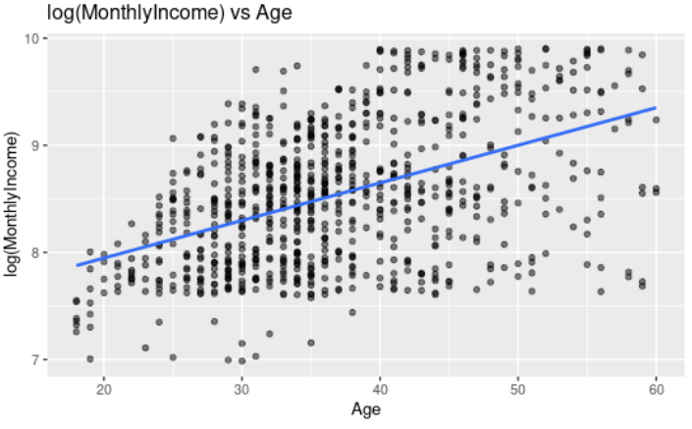
Variable 7:
Age
Positive correlation between Age and log(MonthlyIncome)

Slide 39
Reduced Model Diagnostics
EducationField
Education
Gender
Age
JobLevel
JobRole
Department

Slide 40

Reduced Model Diagnostics
EducationField
Education
Gender
Age
JobLevel
JobRole
Department
K-Fold Cross Validation

Slide 41
Reduced Model Diagnostics
EducationField
Education
Gender
Age
JobLevel
JobRole
Department
K-Fold Cross Validation
Calculated MSPE | 1144827
Calculated RMSE | 1068.742

Slide 42
Full Model
(Every Explanatory Variable)
Reduced Model
Calculated MSPE | 1144827
Calculated RMSE | 1068.742
Calculated MSPE | 1218214
Calculated RMSE | 1102.52
Difference in MSPE of ~ 73000!
These results suggest our reduced model has less error!

Slide 43
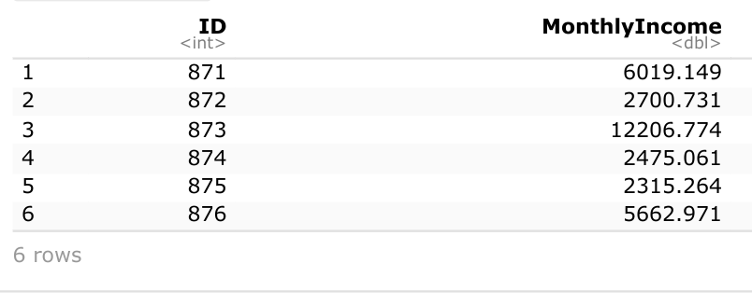
Reduced Model Predictions
Full file available on Github

Slide 44
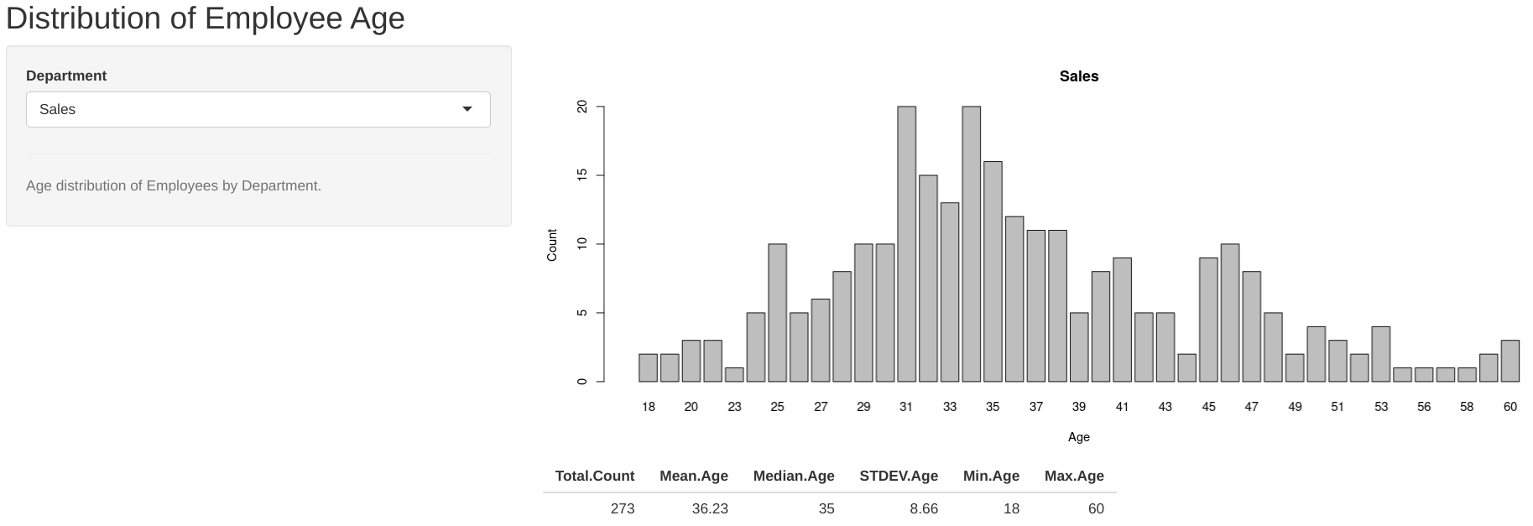
Employee Demographic Application
https://886kdw-joel.shinyapps.io/Employee_Demographics/
Future Endeavors:
Additional Variable Selection - Realtime Variable-Based Prediction
Salary Prediction

Slide 45
Conclusions

Slide 46
Conclusions
Key Takeaways
Naive Bayes model has potential to predict employee attrition within our workforce

Slide 47
Conclusions
Key Takeaways
Naive Bayes model has potential to predict employee attrition within our workforce
Regression modeling enables salary prediction (Possible applications with determining equitable pay of future employees)

Slide 48
Conclusions
Key Takeaways
Naive Bayes model has potential to predict employee attrition within our workforce
Regression modeling enables salary prediction (Possible applications with determining equitable pay of future employees)
Future Projects
Refining models to improve reliability
Increasing applet functionality

Slide 49
Thank you!
Email:
joellaskow@gmail.com
Personal Links:
https://github.com/jlaskow

